Slide 1

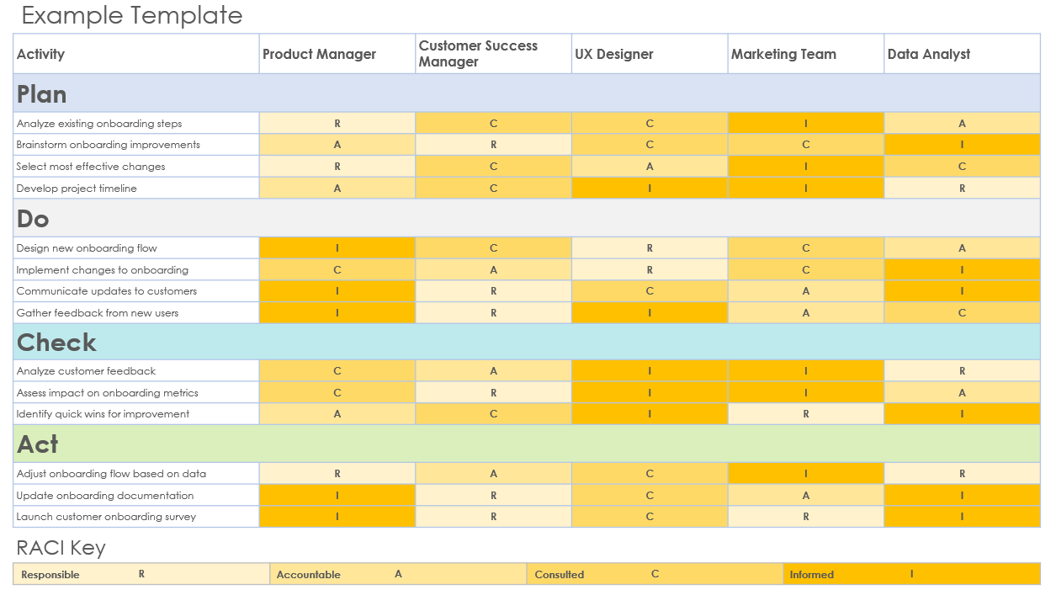
PDCA RACI Matrix Template

Slide 2
Activity | Product Manager | Stakeholder 2 | Stakeholder 3 | Stakeholder 4 | Stakeholder 5
Plan
 | R
 | A
 | C
 | I
Do
Check
Act
RACI Key
R | A | C | I
Responsible
Accountable
Consulted
Informed

Slide 3
Example Template
Activity | Product Manager | Customer Success Manager | UX Designer | Marketing Team | Data Analyst
Plan
Analyze existing onboarding steps | R | C | C | I | A
Brainstorm onboarding improvements | A | R | C | C | I
Select most effective changes | R | C | A | I | C
Develop project timeline | A | C | I | I | R
Do
Design new onboarding flow | I | C | R | C | A
Implement changes to onboarding | C | A | R | C | I
Communicate updates to customers | I | R | C | A | I
Gather feedback from new users | I | R | I | A | C
Check
Analyze customer feedback | C | A | I | I | R
Assess impact on onboarding metrics | C | R | I | I | A
Identify quick wins for improvement | A | C | I | R | I
Act
Adjust onboarding flow based on data | R | A | C | I | R
Update onboarding documentation | I | R | C | A | I
Launch customer onboarding survey | I | R | C | R | I
RACI Key
R | A | C | I
Responsible
Accountable
Consulted
Informed

Slide 4
DISCLAIMER Any articles, templates, or information provided by Smartsheet on the website are for reference only. While we strive to keep the information up to date and correct, we make no representations or warranties of any kind, express or implied, about the completeness, accuracy, reliability, suitability, or availability with respect to the website or the information, articles, templates, or related graphics contained on the website. Any reliance you place on such information is therefore strictly at your own risk.

